Slide 1
K – Nearest Neighbors (K-NN)
To automatically classify a collection of objects based on the classification ALREADY DONE on similar objects
The output of the algorithm is categorical label
K-NN Philosphy
  Each object has attributes
  Consider most similar other items defined in terms of attributes
  Give the unassinged object Majority vote

Slide 2
Two Important Considerations
How do you define similarity or closeness?
  The similarity criteria would be used choose more similar objects and call them neighbors
  Each neighbor has a vote
How many neighbors to choose for voting?
  This value is k
  To be determined by data scientist

Slide 3
k-NN Process
Decide on your similarity or distance metric.
Split the original labeled dataset into training and test data.
Pick an evaluation metric.
Run k-NN a few times, changing k and checking the evaluation measure.
Optimize k by picking the one with the best evaluation measure.
Once you’ve chosen k, use the same training set and now create a new test set that you have no labels for, and want to predict

Slide 4
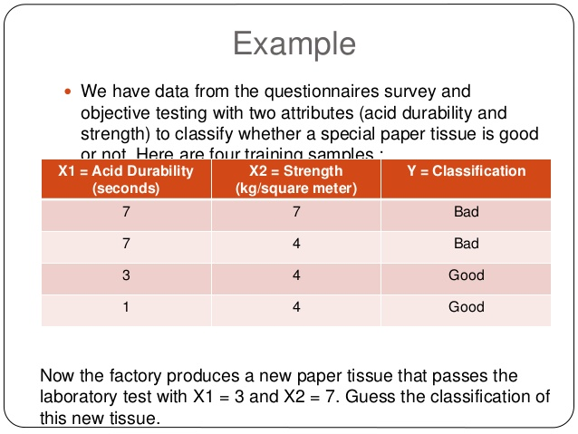

Slide 5
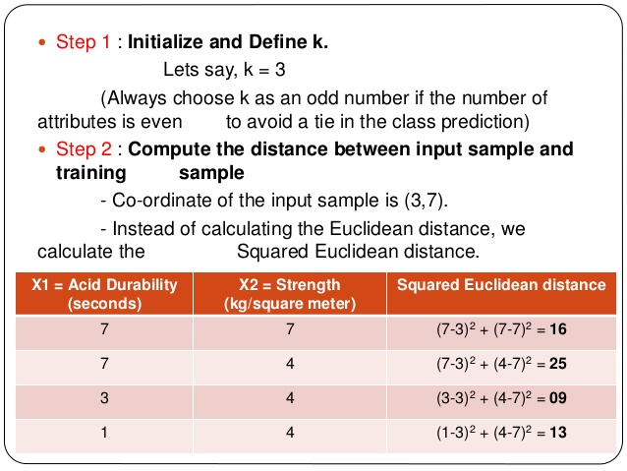

Slide 6
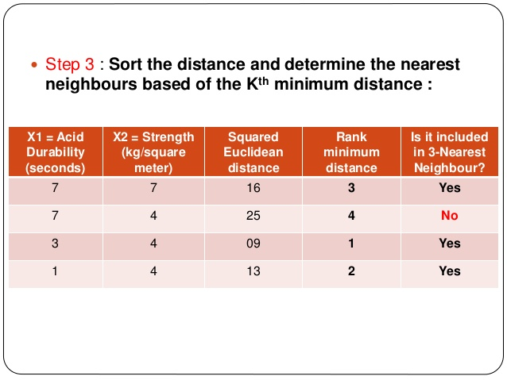

Slide 7
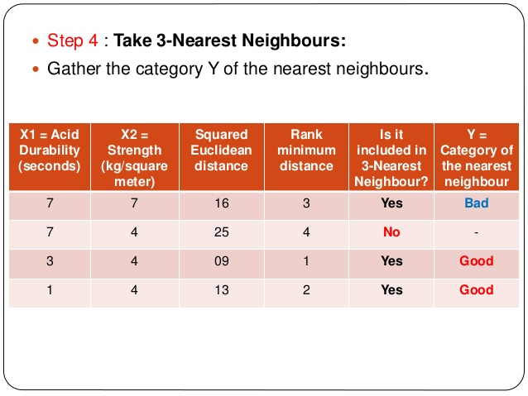

Slide 8
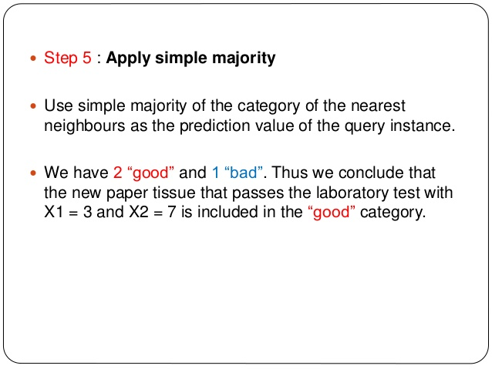

Slide 9
Classifying the IRIS Dataset
We will test our classifier on a scikit learn dataset, called “IRIS”.For importing “IRIS”, we need to import datasets from sklearn and call the function datasets.load_iris().The “IRIS” dataset holds information on sepal length, sepal width, petal length & petal width for three different class of Iris flower – Iris-Setosa, Iris-Versicolour & Iris-Verginica.Based on the data from the dataset, we need to classify them using our classifier.The Sci-kit learn (sklearn) library already holds a pre built classifier.We will compare both the classifiers, [scikitlearn vs the one that we built] and check/compare prediction accuracy of both the classifier .

Slide 10
Using Python
import numpy as np
def distance(p1, p2):
return np.sqrt(np.sum(np.power(p2-p1, 2))) #distance between two points
p1 = np.array([1, 1]) #coordinate x = 1, y = 1
p2 = np.array([4, 4]) #coordinate x = 4, y = 4
distance(p1, p2)

Slide 11
Using sklearn
from sklearn import datasets
import numpy as np
iris = datasets.load_iris()
predictors = iris.data[:, 0:2]
outcomes = iris.target

Slide 12
Prediction using sklearn
from sklearn.neighbors import KNeighborsClassifier
knn = KNeighborsClassifier(n_neighbors = 5)
knn.fit(predictors, outcomes)
sk_predictions = knn.predict(predictors)

Slide 13
Accuracy
print(" prediction by scikit learn : ")
print(100 * np.mean(sk_predictions == outcomes))

